Slide 1


Agriculture Crop Production Analysis
Presented by: Keshav Yadav
Reg. No. 12320523

Slide 2
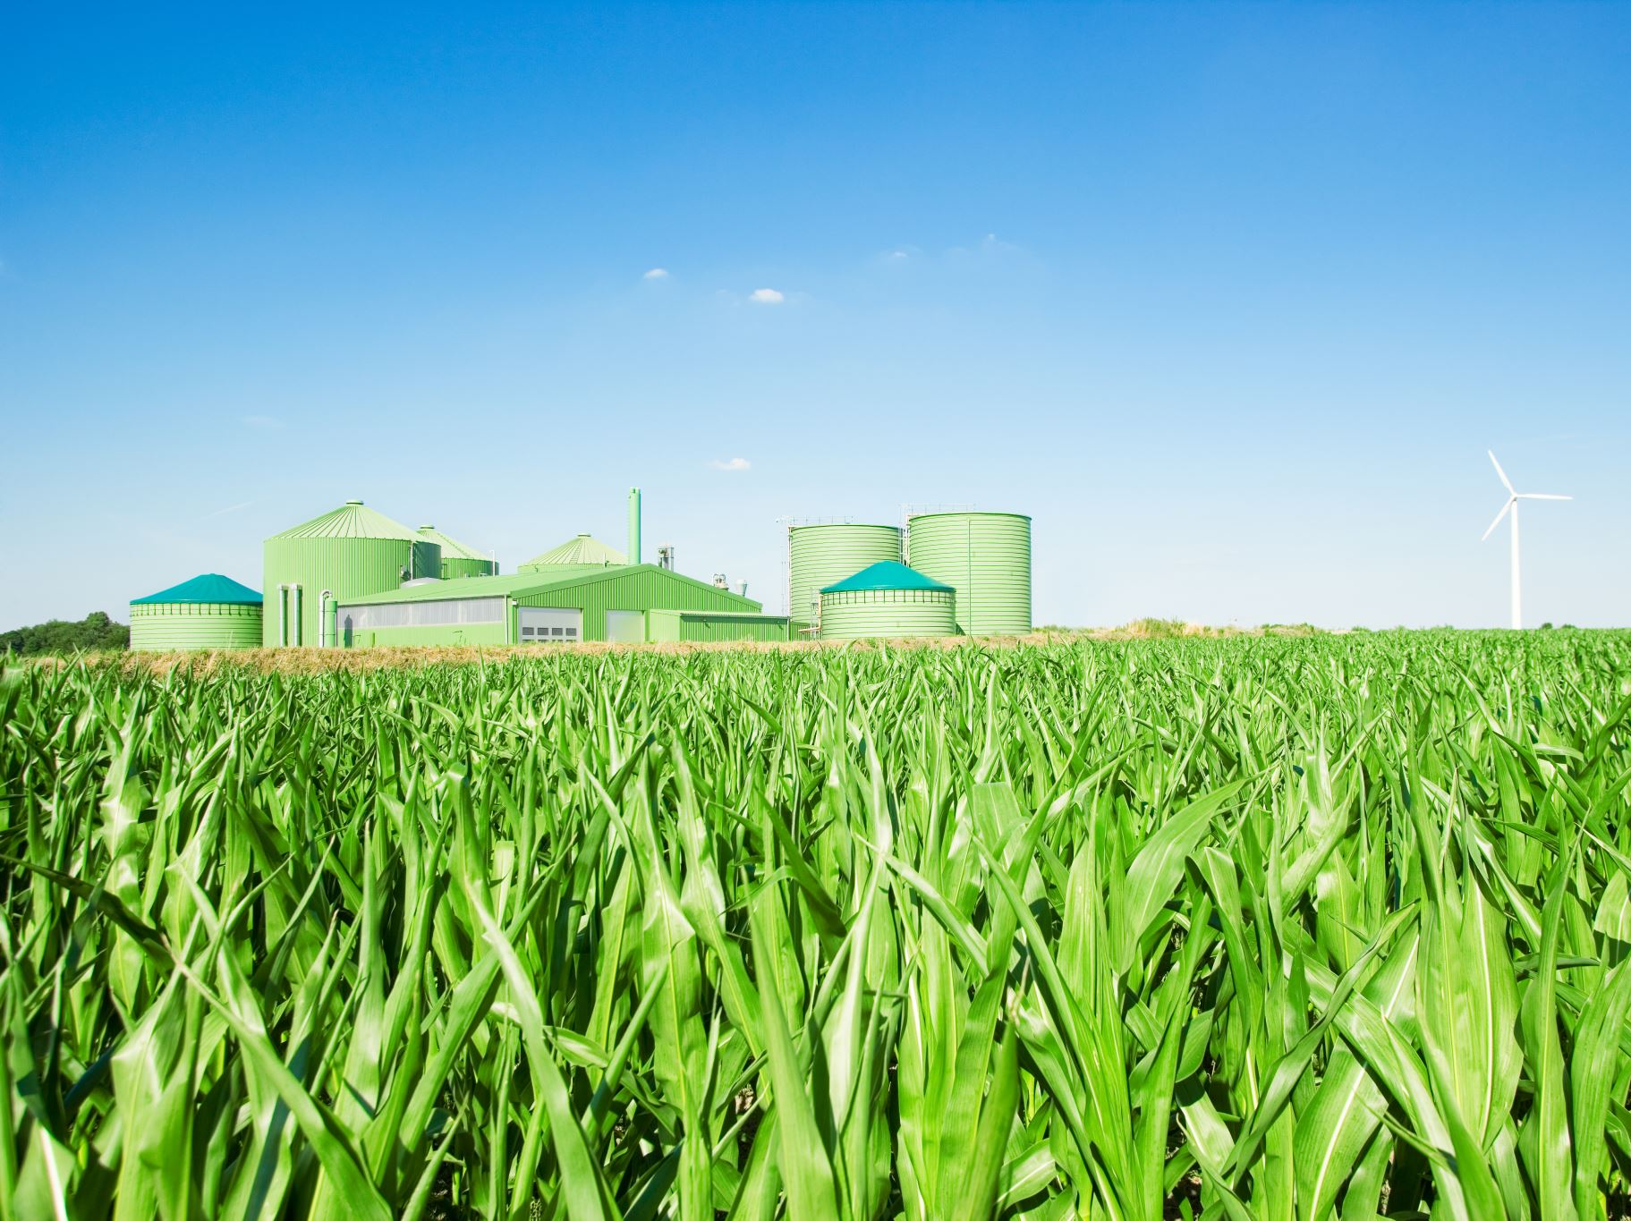
Abstract
Agriculture forms the cornerstone of India’s economy, employing over 60% of the population. However, productivity is often hampered by climate variability, uneven resource distribution, and outdated techniques. This project uses data science tools to analyze agricultural trends, optimize input usage (like electricity and fertilizers), and suggest policy-level reforms. Through regression, EDA, and predictive modeling, we aim to improve yield forecasting and resource planning to support both farmers and policy makers.

Slide 3

Why Agriculture?
Agriculture contributes ~18% to India’s GDP.
Over 50% of rural households depend on farming.
Ensures food security for 1.4 billion citizens.
Has direct implications on inflation and trade.

Slide 4

Motivation for the Study
India has a lot of agricultural data, but many regions still have low crop yields.
Government data is available for public use and can help in research.
Data science can help find problems and improve efficiency in agriculture.
I want to use data analytics to make a positive impact on society.

Slide 5
Data Sources
UBAg: Unified Portal for Agricultural Statistics
Data.gov.in: Open Government Data platform
Dept. of Agriculture and Farmers Welfare: District-level data on area, yield, etc.
Data includes: Crop type, season, production, area, fertilizer usage, electricity consumed.

Slide 6
Column Descriptions in Dataset
Crop Production Data (District-wise):State, District, Crop Season, Area, Production, Yield
Electricity Consumption in Agriculture : Year, State, Electricity Consumption(GWh)

Slide 7
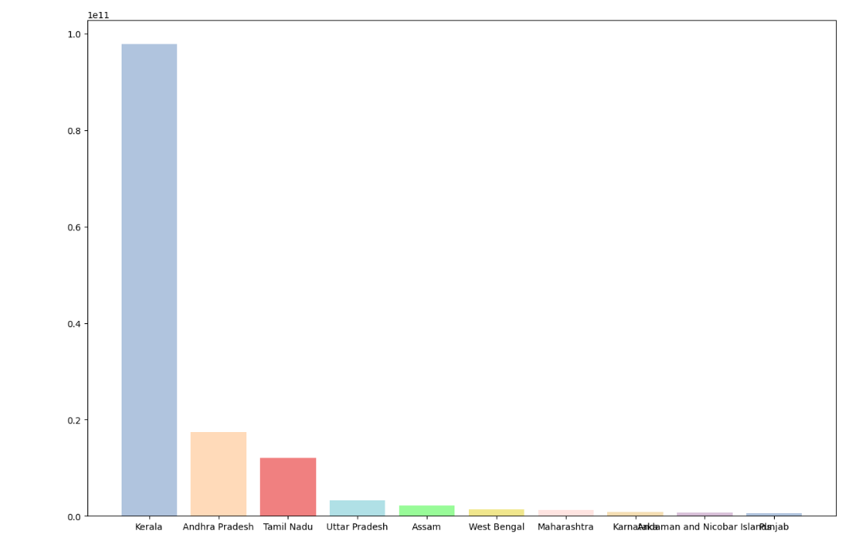
State wise Production
• Each bar is representing a state.
• The length of the bar shows the total crop production.
• The highest production state wise is Kerala..

Slide 8
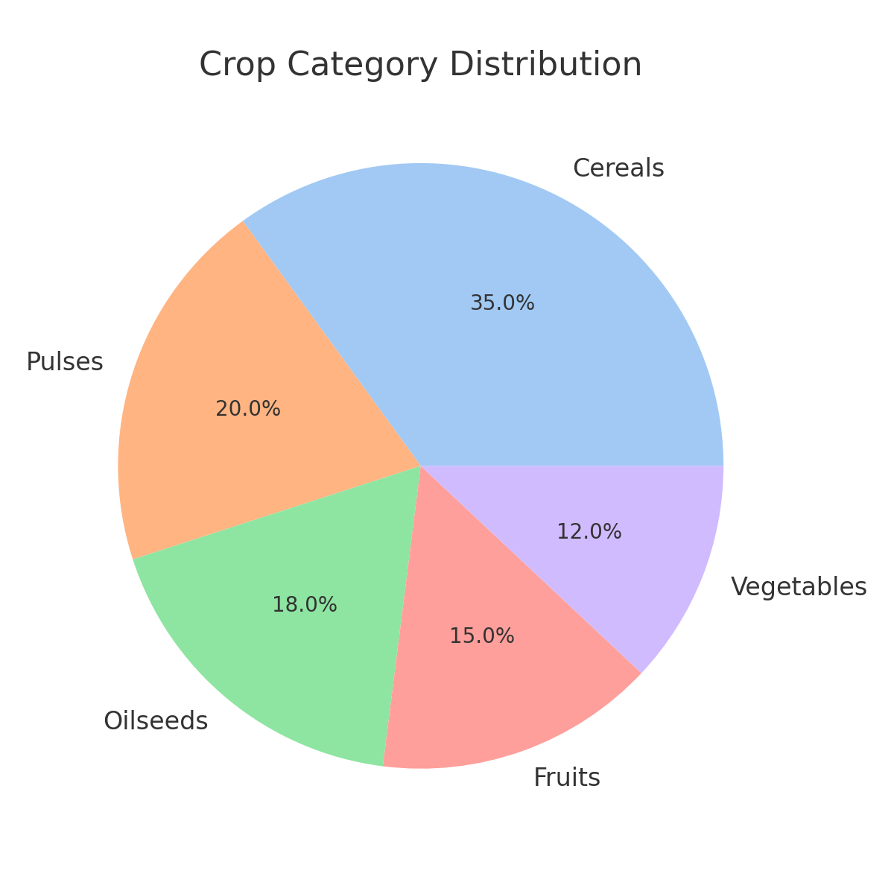

Crop Category Distribution
Crop Category Distribution:
Insight: Cereals, Pulses, and Oilseeds together account for over 70% of production.

Slide 9
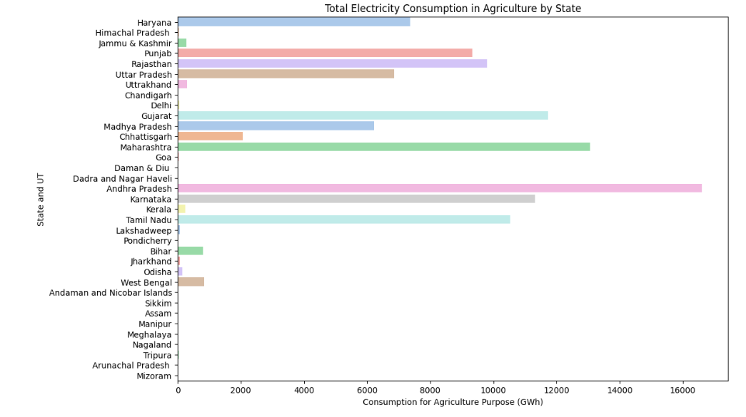
Total Electricity Consumption in Agriculture
• Andhra Pradesh has the highest electricity consumption for agriculture among all states.
• Many northeastern and smaller states (like Sikkim, Mizoram, Arunachal Pradesh) have very low electricity consumption in agriculture.

Slide 10
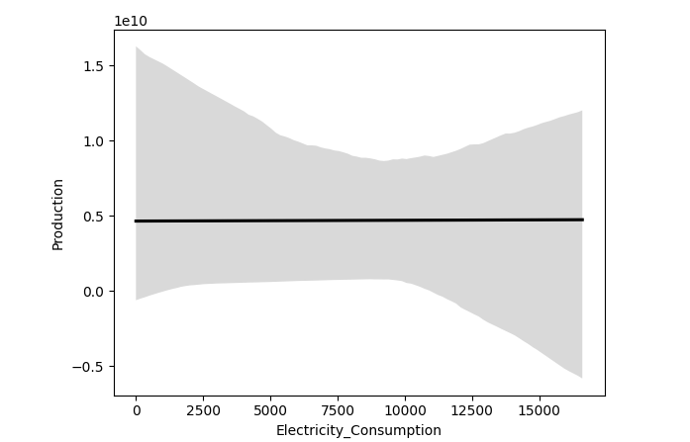
Regression Line Code
• The black line is almost horizontal, this confirms no significant linear relationship between electricity consumption and crop production.
• Wide Confidence Band, The grey shaded area is very wide, especially at the extremes. This means there is high uncertainty in predicting crop production based on electricity usage.
• Electricity consumption alone is not a strong predictor of crop production.

Slide 11
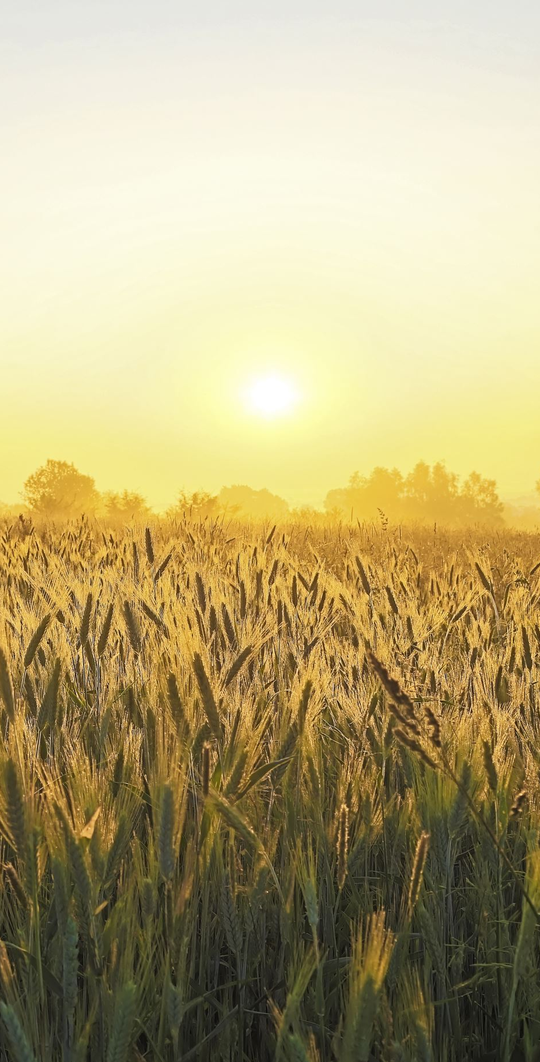
Conclusion
This study gives a clear understanding of how crop production and electricity use are connected in Indian farming. It not only looks at the current situation but also opens-up opportunities for future research in areas like predicting crop yields and energy use using ma chine learning, and analyzing data based on location. The findings highlight how important it is to use data to make better decisions that can improve farming, save energy, and help create better policies. Moving forward, using these methods will be key to ensuring sustainable growth, fair resource distribution, and stronger agriculture in India.

